Slide 1
Business Analytics Using Power BI
A Data-Driven Approach to Retail Performance
Vamshidhar reddy kallakuntla
ISM 6404 – Introduction to Business Analytics
Florida Atlantic University

Slide 2
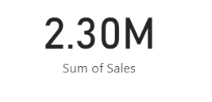
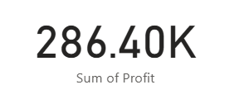
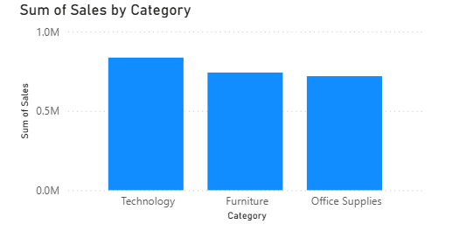
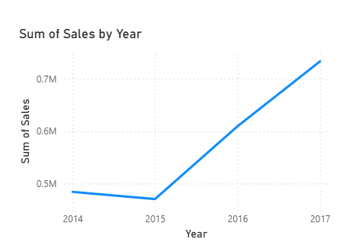
Act One: Current Reality
Where are we?
Total Sales: $2.30M
Total Profit: $286.40K
2014 → 2017 trend: steady sales growth
Technology leads in Sales & Profit (Dashboard: bar chart)
Furniture & Office Supplies generate lower profit
West region performs best → scalable model
So What?
“Business is growing but profit margin (~12.3%) is constrained by heavy discounting, especially in Furniture category.”

Slide 3
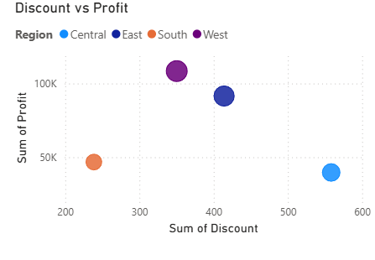
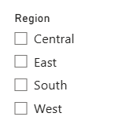
Act Two: Hidden Opportunity
Technology drives highest profit in the West region
Excessive discounting >15% reduces profit, especially in Furniture
Central region profitability is ~22% lower than West
Insight | Canvas Component
Tech profit advantage in West | Customer Segments · Revenue Streams
Discount control improves profitability | Value Proposition · Cost Structure
Regional strategy optimization | Channels · Key Activities
Unified Data Insight
“Sales growth is driven by Technology and strong regions like West, but aggressive discounting — mainly in Furniture — reduces profit. Implementing region-based pricing strategy and discount optimization can increase profitability.”
How do we know?
Analysis of 9,994 records
Bubble chart shows discount ↑ → profit ↓
West region retains profitability → scalable pricing strategy

Slide 4
ACT THREE: THE PATH FORWARD
What do we do now?
Strategic & SMART Recommendations
Recommendation | Business Impact | Resources & Cost | ROI
Limit Furniture discount to <12% | +$18K profit/year | ~$5K | 3.6×
Expand Technology-focused strategy to East & Central regions | +$42K additional sales/year | ~$10K | 4.2×
Apply West region pricing model in Central | +$25K profit increase/year | ~$7K | 3×
Total Estimated Gain: ~$85,000 annual improvement
Implementation Timeline: Q1–Q2 2025
KPIs: Profit margin ↑14%, discount loss ↓20%, Central region ROI ↑10%

Slide 5
BUSINESS MODEL CANVAS MAPPING
Strategic Insight | Business Model Canvas Component
Technology drives highest profit in West | Customer Segments
Discount reduction improves profitability | Value Proposition
Apply West pricing model to Central region | Channels
Profit gain of ~$85K annually (projected) | Revenue Streams
Pricing strategy redesign & optimization | Key Activities
Reducing discount dependency lowers cost impact | Cost Structure

Slide 6
Call to Action
To drive profitability and strengthen market positioning, I recommend immediate implementation of pricing optimization and expansion strategy starting Q1 2025.

Slide 7
Q&A
Can elaborate on analysis methodology
Can explain dashboard interaction
Can justify business ROI & feasibility
Open to discussing implementation roadmap

Slide 8
THANK YOU

